Slide 1


FIFA 2022
Players’ Market Value Analysis

Slide 2

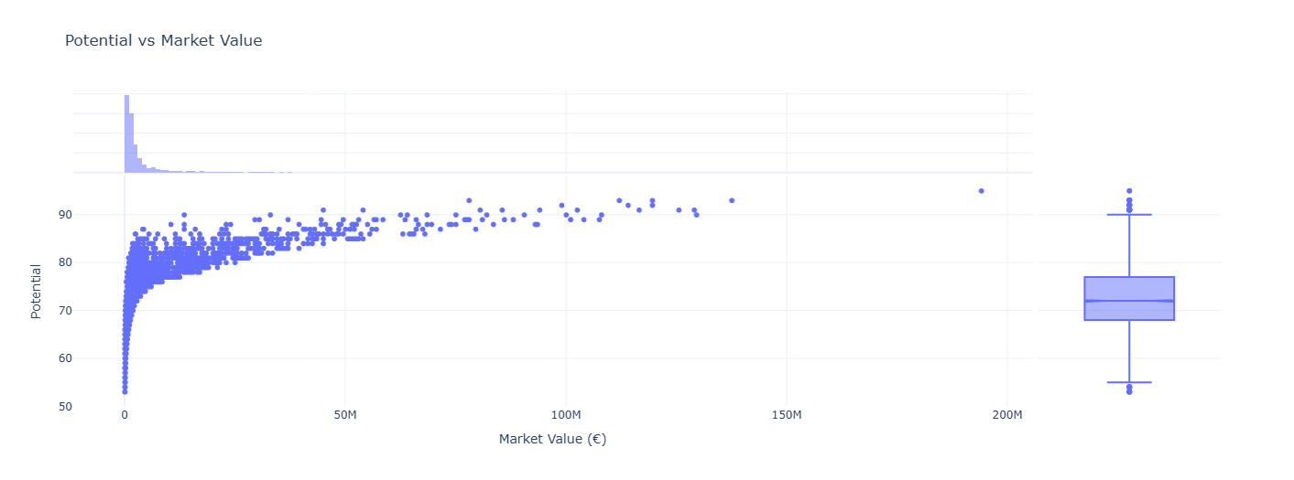

TOP THREE INSIGHTS
1. Player’s Potential vs Market Value (€)
The graph below shows a relationship between player’s potential and their market value. As potential rating increase, market value generally rises as well. However, this growth doesn't follow a straight linear trend — it appears more polynomial.
We can see similar pattern for the overall feature.

Slide 3
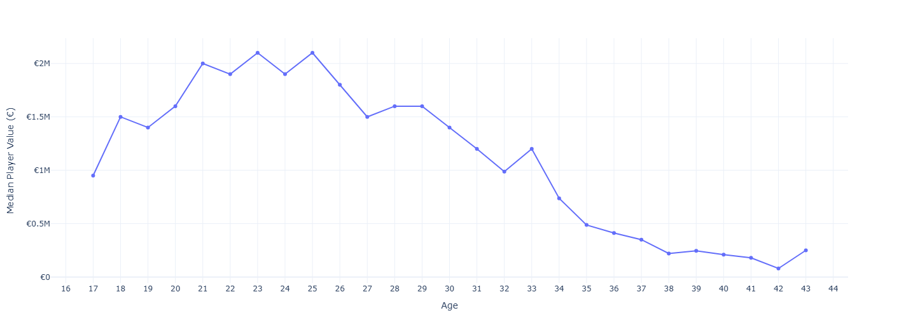
TOP THREE INSIGHTS
2. Players’ Age vs Median Market Value (€)
We observe a pattern linking a player's market value to their age, with values rising from age 17, peaking between 20 and 25, and then declining after 25.

Slide 4
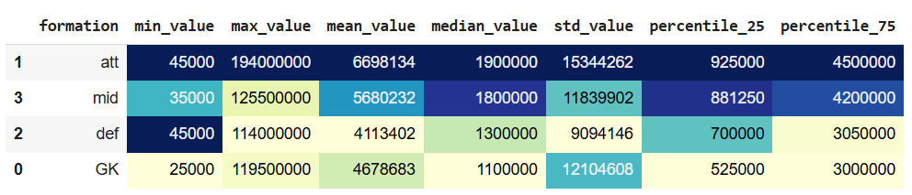
TOP THREE INSIGHTS
3. Players’ Formation vs Market Value (€)
Attackers have the highest market value, followed by midfielders. Defenders and goalkeepers are generally less valuable.

Slide 5
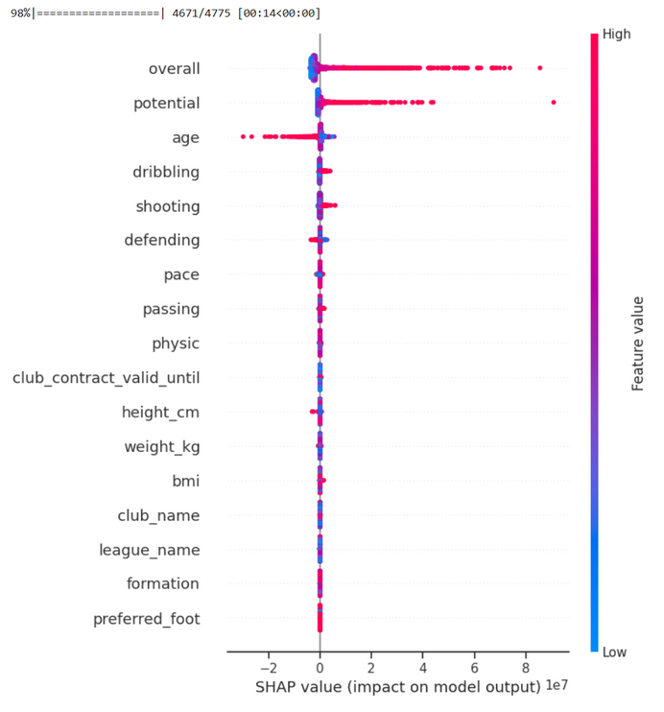
MOST INFORMATIVE FEATURES
Choose features that can be most informative, when trying to estimate player's value ("value_eur" column) and explain why.
I would choose the following features:
overall & potential - polynomial pattern for relationship between value_eur has been identified;
age - there is a clear pattern between age and median for value_eur;
performance indicators such as pace, passing, dribbling, shooting and defending;
club name - in general, players from certain top clubs (like Liverpool, PSG, etc.) tend to have much higher market values.
SHAP - Feature Importance:
SHAP values for XGBRegressor identified :
overall
potential
age
dribbling
shooting

Slide 6
EXECUTIVE SUMMARY
Key factors identified for predicting a player's market value:
Key Drivers of Player Value: A player's overall skill rating, potential, and age are the most important factors impacting their market value in FIFA 2022.
Skill Attributes Matter: Specific abilities like dribbling, shooting, defending, and pace also influence value, but to a lesser extent compared to overall ratings.
High Ratings Increase Value: Players with higher skill and potential ratings tend to have much higher transfer values, as shown by the positive impact on model predictions.

